Slide 1
Linear Filtering
Juan Park, Graduate Research Assistant
Chul Min Yeum, Assistant Professor
Civil and Environmental Engineering
University of Waterloo, Canada
CIVE 497 – CIVE 700: Smart Structure Technology
Last updated: 2020-01-24

Slide 2

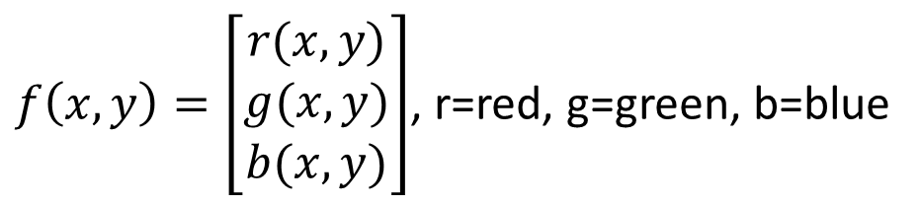
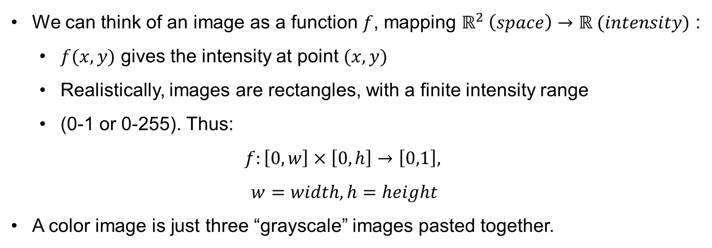
Image as Functions
We can think of an image as a function $f$, mapping $ℝ^{2} \left(space\right)→ℝ (intensity)$ :
$f(x,y)$ gives the intensity at point $(x,y)$
Realistically, images are rectangles, with a finite intensity range
(0-1 or 0-255). Thus:
$$f:\left[0,w\right]×\left[0,h\right]→\left[0,1\right],$$
$$w=width, h=height$$
A color image is just three “grayscale” images pasted together.
$f\left(x,y\right)=\left[\begin{matrix}r(x,y) \\ g(x,y) \\ b(x,y)\end{matrix}\right]$, r=red, g=green, b=blue
*RGB isn’t the only color space! There are others, like YCbCr, sRGB, CMY…

Slide 3
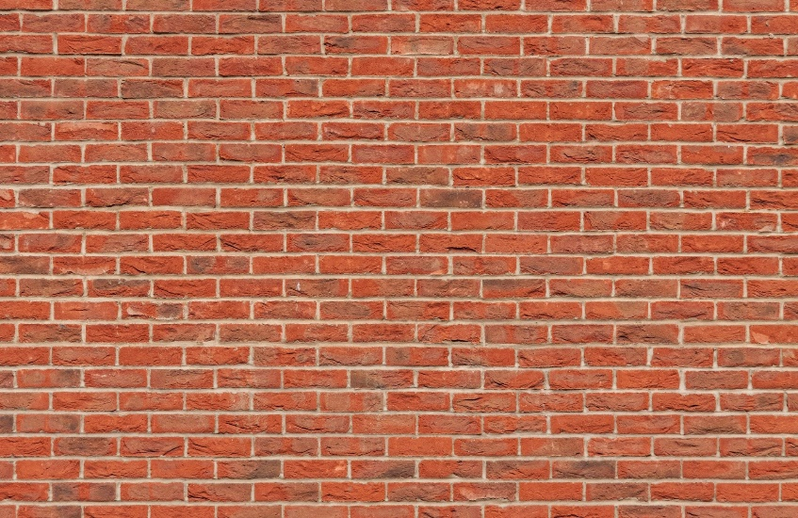
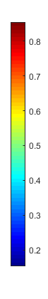
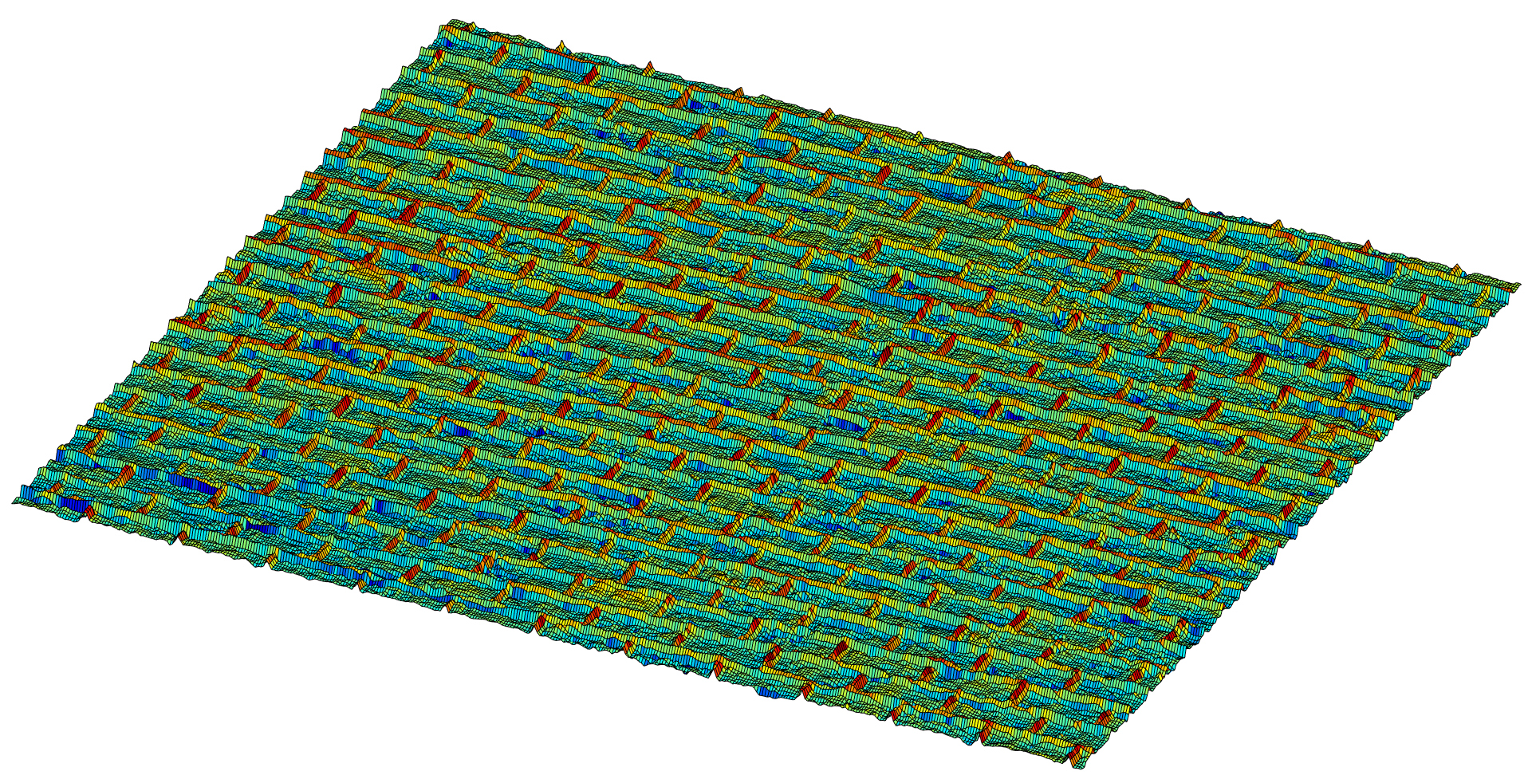
Image as Functions (Continue)
RGB
f(X, Y)
X
Y
Gray

Slide 4
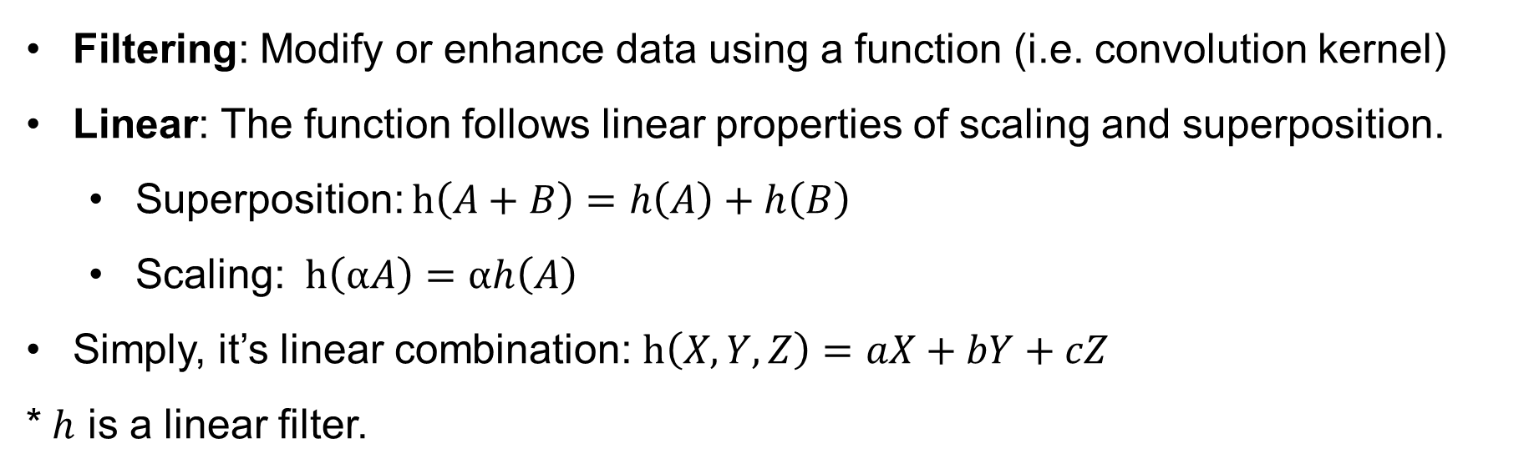
Linear Filtering?
Filtering: Modify or enhance data using a function (i.e. convolution kernel)
Linear: The function follows linear properties of scaling and superposition.
Superposition: $h\left(A+B\right)=h\left(A\right)+h\left(B\right)$
Scaling: $h\left(αA\right)=αh\left(A\right)$
Simply, it’s linear combination: $h\left(X,Y,Z\right)=aX+bY+cZ$
* $h$ is a linear filter.

Slide 5
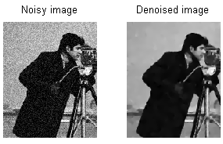
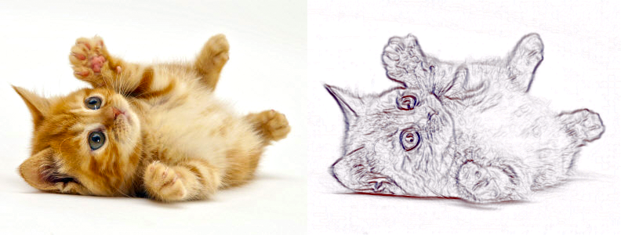
Linear Filtering?
Linear filtering is used to:
Reduce noise in data
Extract features from data

Slide 6
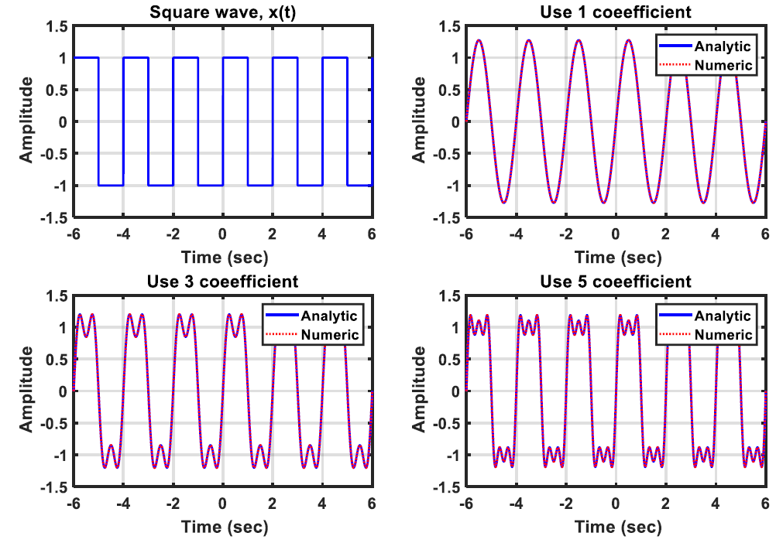
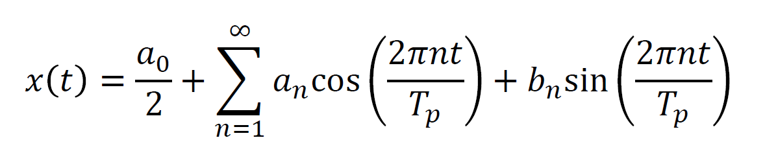
Recall: 1D Signal Interpreted using Fourier Series
Remember the square wave function and its Fourier series approximations?
Period = 2

Slide 7
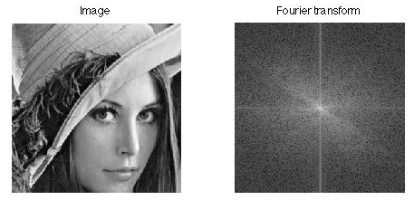
Back to images: Image Interpreted in a Frequency Domain
Here is an image and its Fourier transform (remember Tp=infinity):
Low frequency (LF) ≈ solid colors
High frequency (HF) ≈ noise/edges
origin
Frequency axis 1
LF
HF
Frequency axis 2

Slide 8
Question?
What is blur?
What is low resolution?

Slide 9
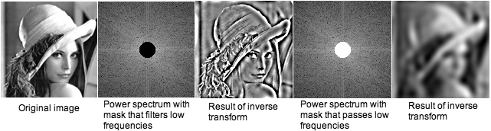
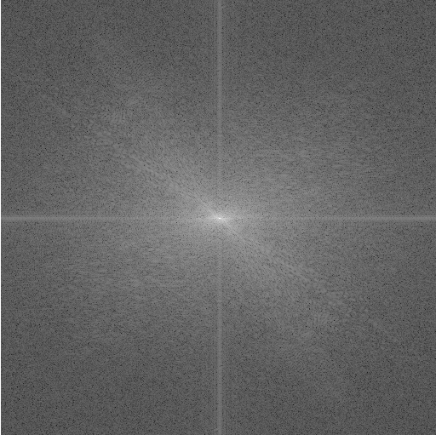
Back to images: Image Interpreted in a Frequency Domain
If we remove low frequencies of an image, what do we get?
How about high frequencies?
https://imagej.nih.gov/ij/docs/images/fft.jpg
Key point: Multiplication in the frequency domain is convolution in the spatial/time domain!

Slide 10
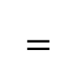



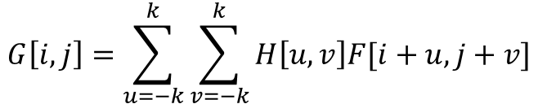
2D Cross-Correlation Example
Cross-correlation is a measure of similarity between two images. Cross correlation with a kernel can be viewed as comparing a litter “picture” or “region” of what you want to find across all sub-regions in the image.
$$G\left[i,j\right]=\sum_{u=−k}^{k}{\sum_{v=−k}^{k}{H\left[u,v\right]F[i+u,j+v]}}$$
Point i, j
0 | 0 | 0 | 1 | 0 | 0 | 0
0 | 1 | 1 | 1 | 0 | 0 | 0
0 | 1 | 1 | 1 | 0 | 1 | 1
0 | 1 | 1 | 1 | 1 | 0 | 0
0 | 0 | 0 | 0 | 1 | 0 | 0
0 | 1 | 0 | 0 | 0 | 0 | 0
0 | 0 | 0 | 0 | 1 | 1 | 1
$$F$$
4 | 7 | 5 | 4 | 2
6 | 9 | 7 | 5 | 3
4 | 6 | 6 | 5 | 4
3 | 4 | 4 | 3 | 2
1 | 1 | 2 | 3 | 4
$$F$$
1 | 1 | 1
1 | 1 | 1
1 | 1 | 1
$$⨂$$
$$=$$

Slide 11
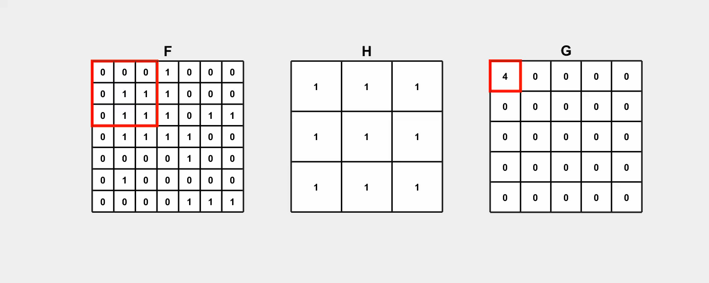
Computation of the Cross-Correlation Between Two Matrices

Slide 12
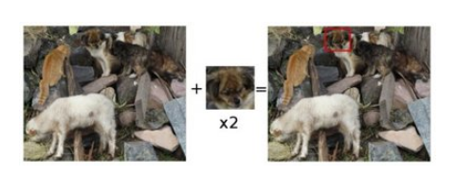
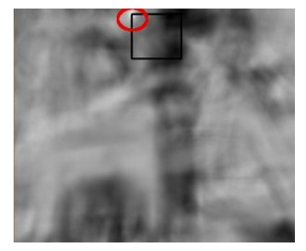
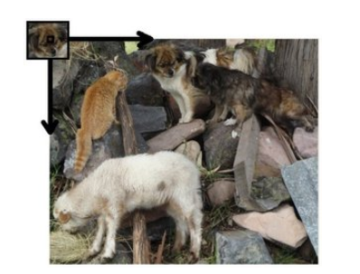
Example: Finding Same Objects on Images
https://docs.opencv.org/2.4/doc/tutorials/imgproc/histograms/template_matching/template_matching.html
Q: Do we need CNN?

Slide 13
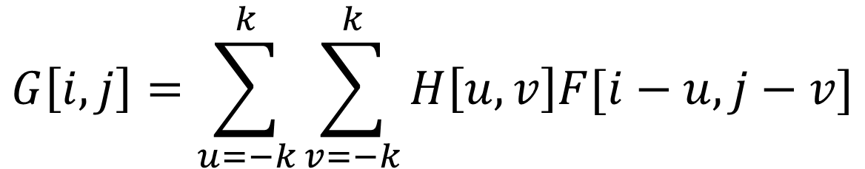
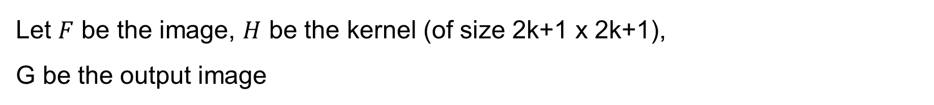
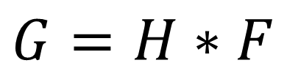
2D Convolution
Let $F$ be the image, $H$ be the kernel (of size 2k+1 x 2k+1),
G be the output image
$$G\left[i,j\right]=\sum_{u=−k}^{k}{\sum_{v=−k}^{k}{H\left[u,v\right]F[i−u,j−v]}}$$
Only difference is that the kernel is “flipped” horizontally and vertically.
This is called a convolution operation:
$$G=H∗F$$

Slide 14
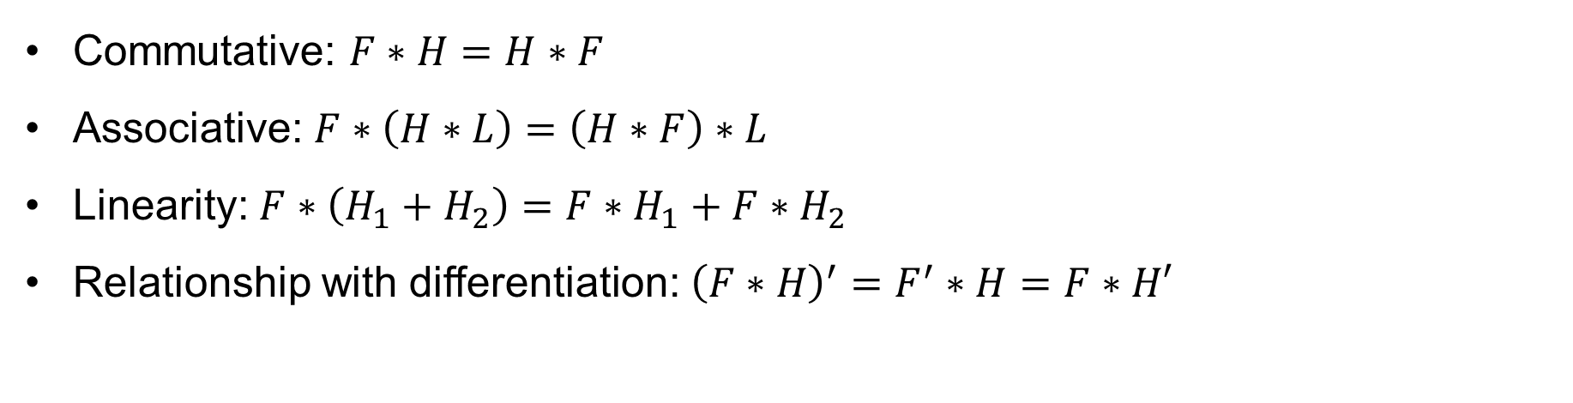
Convolution Properties: Commutative, Associative, and Linearity
Commutative: $F∗H=H∗F$
Associative: $F∗\left(H∗L\right)=\left(H∗F\right)∗L$
Linearity: $F∗\left(H_{1}+H_{2}\right)=F∗H_{1}+F∗H_{2}$
Relationship with differentiation: ${\left(F∗H\right)}^{′}=F^{′}∗H=F∗H′$

Slide 15
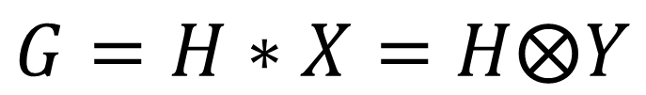



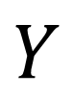
Difference between Cross-Correlation and Convolution
$$X$$
$$Y$$
The basic difference between convolution and cross-correlation is that the convolution process flips the kernel horizontally and vertically.
A | B | C
D | E | F
G | H | I
I | H | G
F | E | D
C | B | A
Usage
Cross-Correlation: Process to measure a similarity between two signals.
Convolution: Process to transform a signal to another signal.
$$G=H∗X=H⨂Y$$
$$⨂$$
cross-correlation
$$∗$$
convolution
Notes:
https://www.mathworks.com/matlabcentral/answers/264746-difference-between-convolution-and-correlation

Slide 16
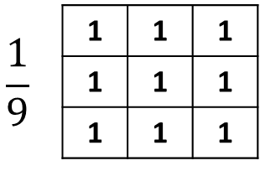
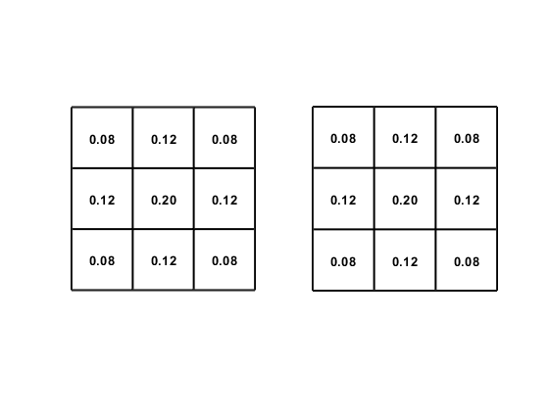
Guessing Game! Linear Filter: Generating an Identical Image
0 | 0 | 0
0 | 1 | 0
0 | 0 | 0
0 | 0 | 0
0 | 0 | 1
0 | 0 | 0
-0.11 | -0.11 | -0.11
-0.11 | 1.89 | -0.11
-0.11 | -0.11 | -0.11

Slide 17


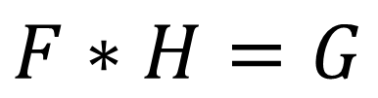
Guessing Game! Linear Filter: Generating an Identical Image
$$∗$$
0 | 0 | 0
0 | 1 | 0
0 | 0 | 0
$$=$$
$$F∗H=G$$

Slide 18
Guessing Game! Linear Filter: Shifting Pixels
0 | 0 | 0
0 | 1 | 0
0 | 0 | 0
0 | 0 | 0
0 | 0 | 1
0 | 0 | 0
-0.11 | -0.11 | -0.11
-0.11 | 1.89 | -0.11
-0.11 | -0.11 | -0.11

Slide 19
Guessing Game! Linear Filter: Shifting Pixels
$$∗$$
0 | 0 | 0
0 | 0 | 1
0 | 0 | 0
$$=$$
$$F∗H=G$$

Slide 20
Guessing Game! Linear Filter: Blurring
0 | 0 | 0
0 | 1 | 0
0 | 0 | 0
0 | 0 | 0
0 | 0 | 1
0 | 0 | 0
-0.11 | -0.11 | -0.11
-0.11 | 1.89 | -0.11
-0.11 | -0.11 | -0.11

Slide 21

Guessing Game! Linear Filter: Blurring
$$∗$$
1 | 1 | 1
1 | 1 | 1
1 | 1 | 1
$$=$$
$$\frac{1}{9}$$
$$F∗H=G$$

Slide 22
Guessing Game! Linear Filter: Sharpening
0 | 0 | 0
0 | 1 | 0
0 | 0 | 0
0 | 0 | 0
0 | 0 | 1
0 | 0 | 0
-0.11 | -0.11 | -0.11
-0.11 | 1.89 | -0.11
-0.11 | -0.11 | -0.11

Slide 23
Guessing Game! Linear Filter: Sharpening
$$∗$$
-0.11 | -0.11 | -0.11
-0.11 | 1.89 | -0.11
-0.11 | -0.11 | -0.11
$$=$$
$$F∗H=G$$

Slide 24
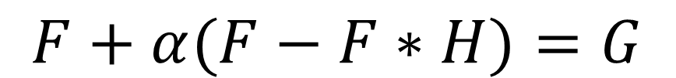




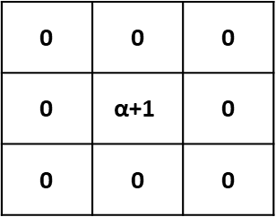
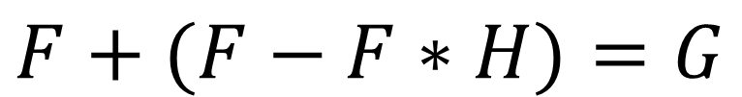
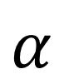
How the Sharpening Filter Works
0 | 0 | 0
0 | 2 | 0
0 | 0 | 0
0.11 | 0.11 | 0.11
0.11 | 0.11 | 0.11
0.11 | 0.11 | 0.11
-0.11 | -0.11 | -0.11
-0.11 | 1.89 | -0.11
-0.11 | -0.11 | -0.11
$$−$$
$$=$$
$$F+(F−F∗H)=G$$
0 | 0 | 0
0 | $$\text{α}\text{+1}$$ | 0
0 | 0 | 0
0.11 | 0.11 | 0.11
0.11 | 0.11 | 0.11
0.11 | 0.11 | 0.11
-0.11α | -0.11α | -0.11α
-0.11α | 1+0.89α | -0.11α
-0.11α | -0.11α | -0.11α
$$−$$
$$=$$
$$α$$
$$F+α(F−F∗H)=G$$

Slide 25
How the Sharpening Filter Works (Signal Example) (Continue)

Slide 26
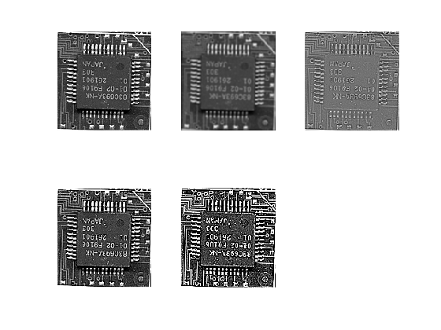
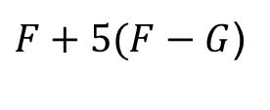
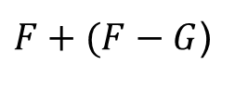
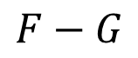
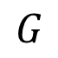

How the Sharpening Filter Works (Image Example)
$$F$$
$$G$$
$$F−G$$
$F+5(F−G$)
$F+(F−G$)

Slide 27
Guessing Game! Gaussian Kernel
0 | 0 | 0
0 | 1 | 0
0 | 0 | 0
0 | 0 | 0
0 | 0 | 1
0 | 0 | 0
-0.11 | -0.11 | -0.11
-0.11 | 1.89 | -0.11
-0.11 | -0.11 | -0.11

Slide 28
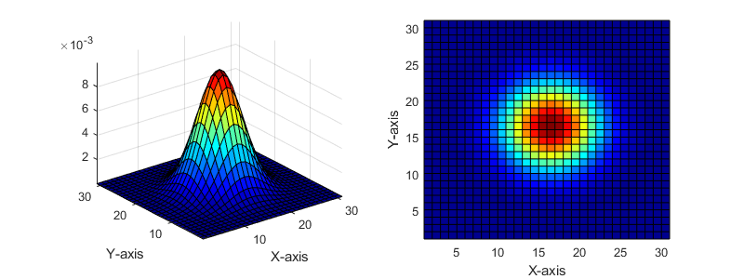
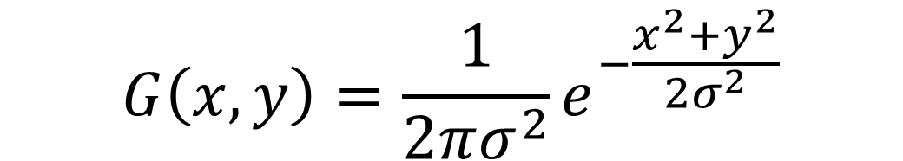
Gaussian Kernel
$$G\left(x,y\right)=\frac{1}{2πσ^{2}}e^{−\frac{x^{2}+y^{2}}{2σ^{2}}}$$

Slide 29
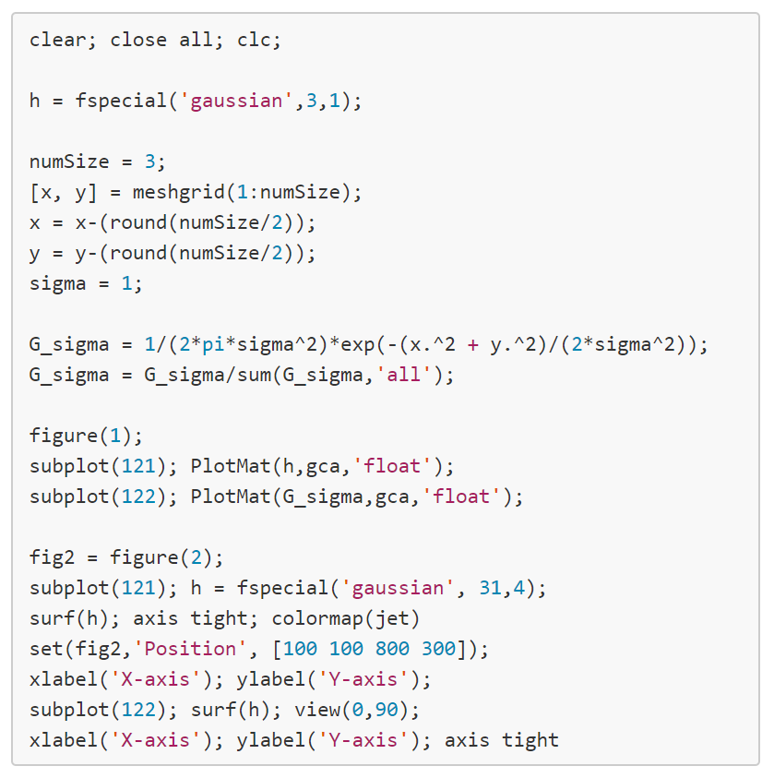
Gaussian Filter

Slide 30
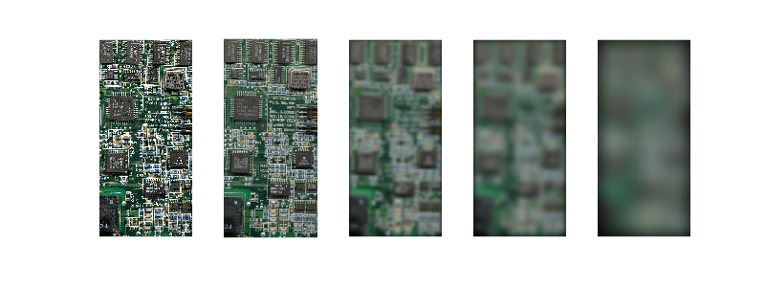
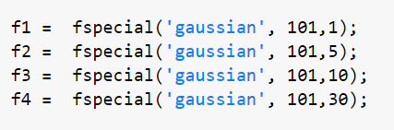
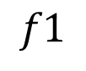
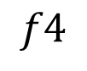
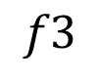
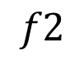
Effect of Gaussian Window Sizes
$$f1$$
$$f2$$
$$f3$$
$$f4$$
Std=1
Std=5
Std=10
Std=30

Slide 31
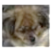
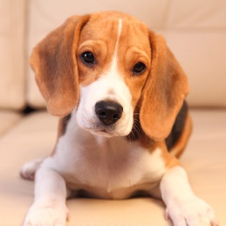
Challenges (template matching) !!!!!!

Slide 32
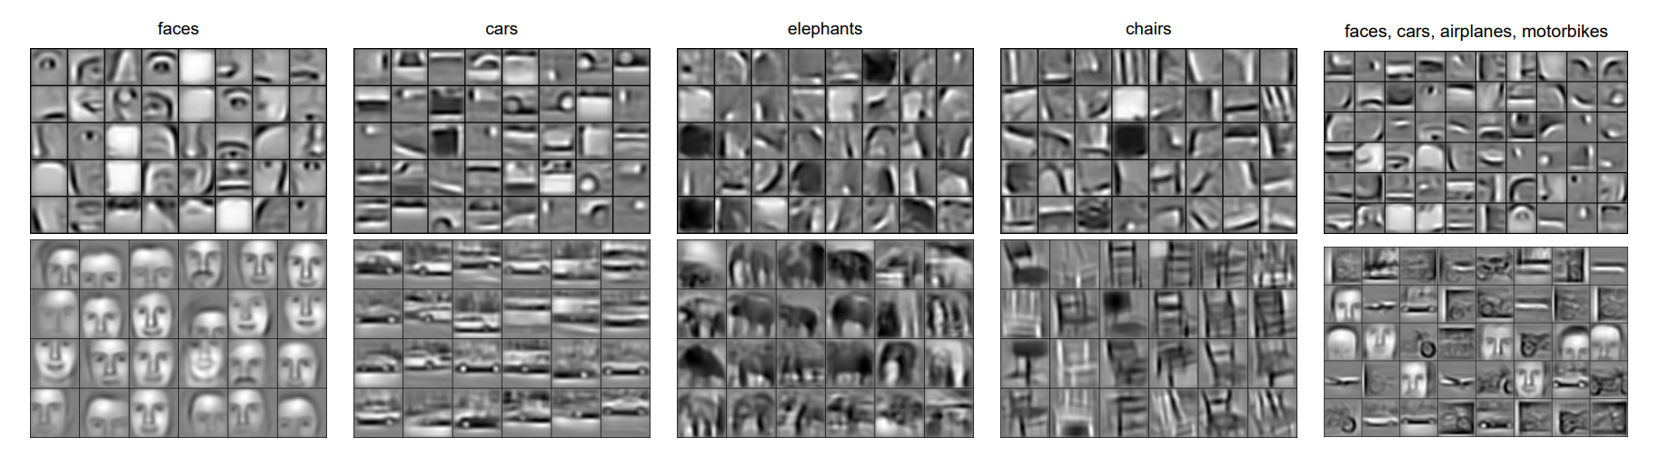
Applications: Convolution Neural Network
http://web.eecs.umich.edu/~honglak/icml09-ConvolutionalDeepBeliefNetworks.pdf

